Slide 1
GPS Measurements
Sanae Matsuki
EECE 5698-Robotic Sensing and Navigation
Homework #3

Slide 2
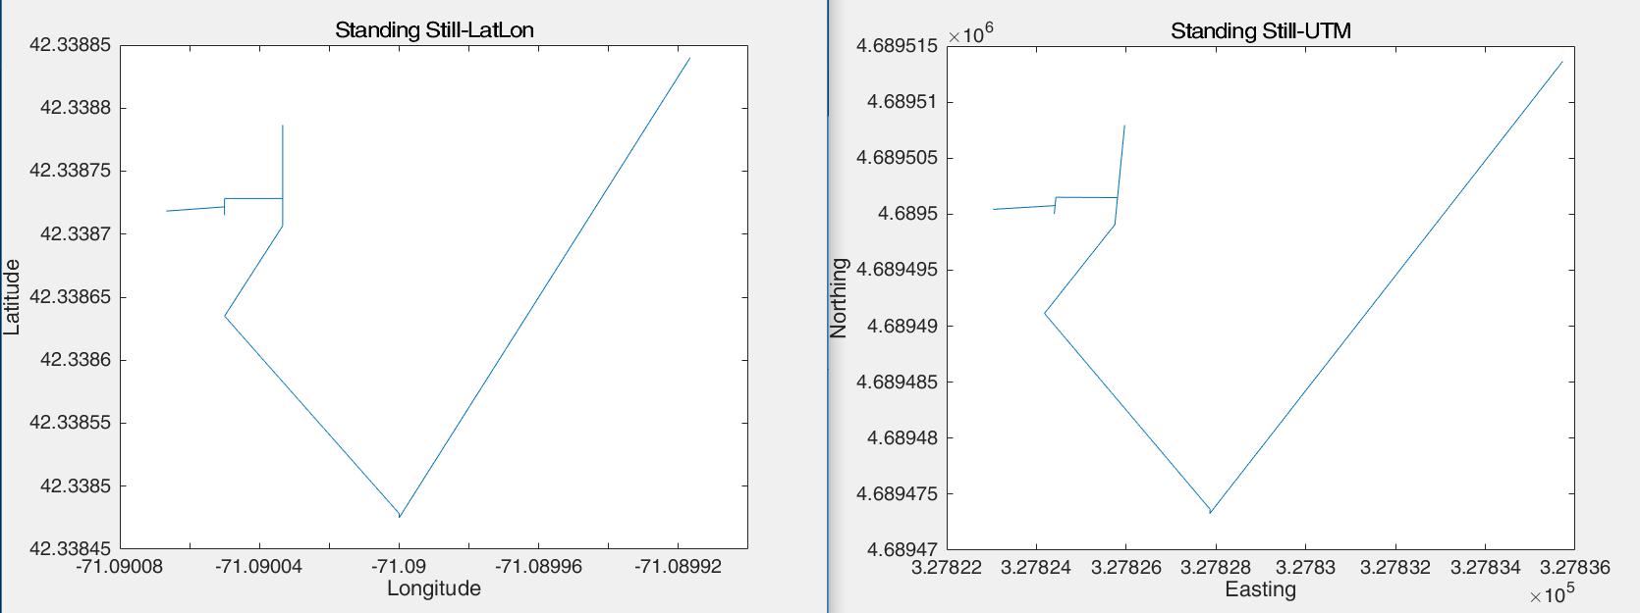
Static, 10 Minutes

Slide 3
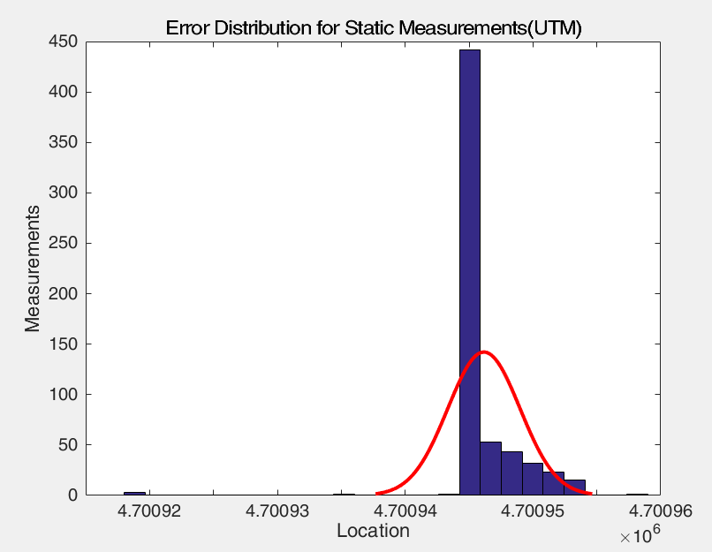
Distribution of Static Measurements

Slide 4
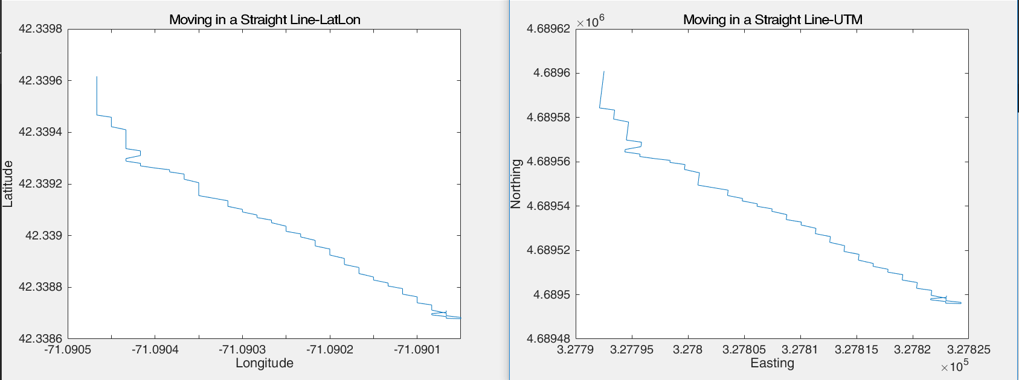
Moving in a Straight Line, 1 minute

Slide 5
Error:
I would have used the input from HDOP (horizontal dilution of precision) to looked further into the error.
I would have expected about 5 meters of planar/horizontal error.
If I walked in a straight line on an incline, I would have most likely seen even more error.
I also expect that from taking tests within Northeastern campus, surrounded by tall buildings, might have affected my GPS signal → creating a multipath interference

